Slide 1
API TESTING

Slide 2
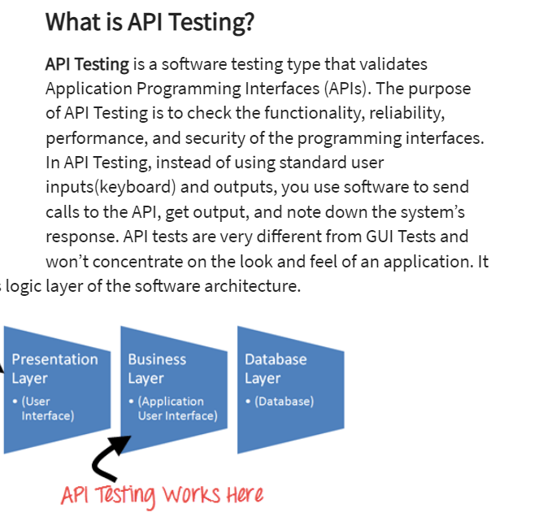
What is API Testing

Slide 3
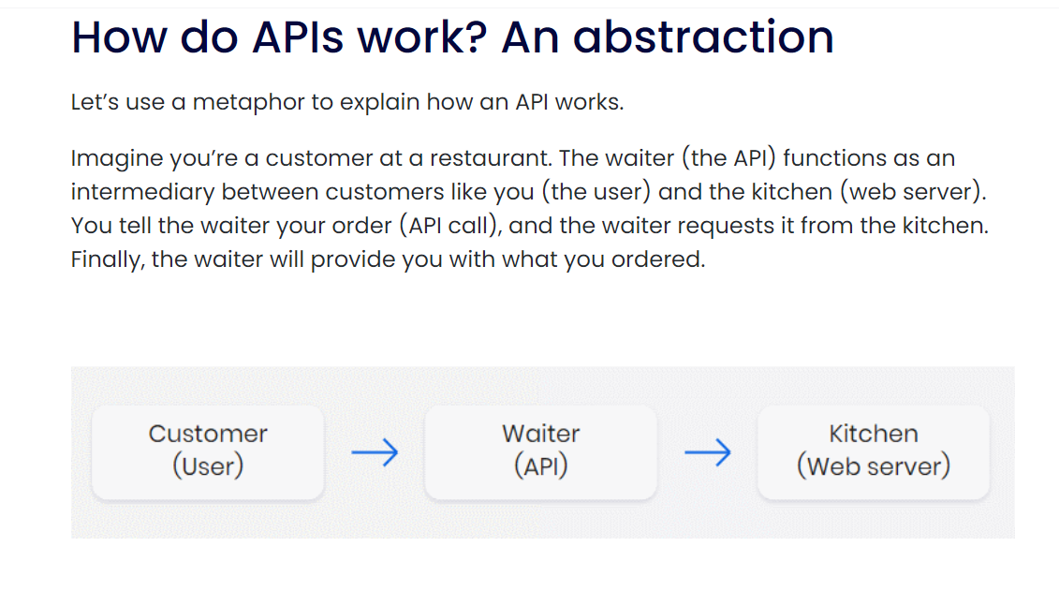
How API Works

Slide 4
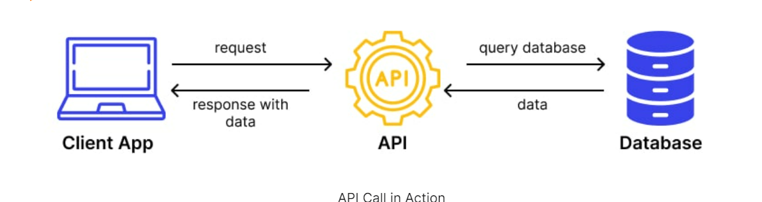
How API Calling takes Place

Slide 5
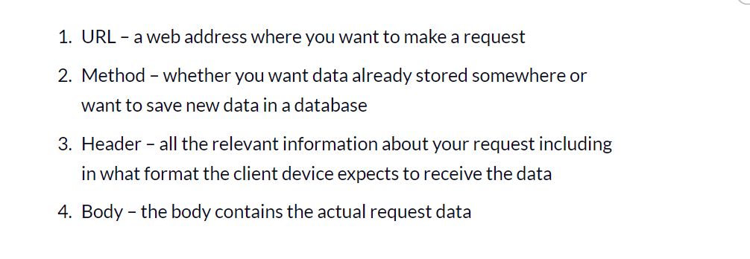
Set of Information required for API

Slide 6
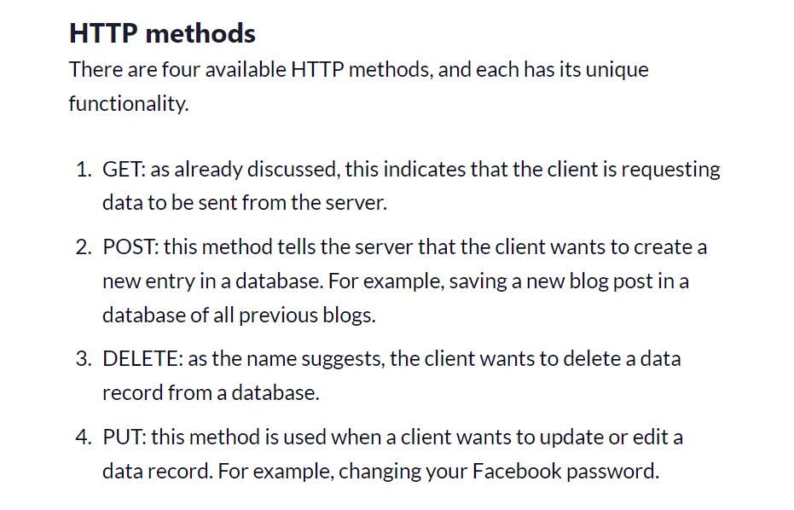
HTTP Methods

Slide 7
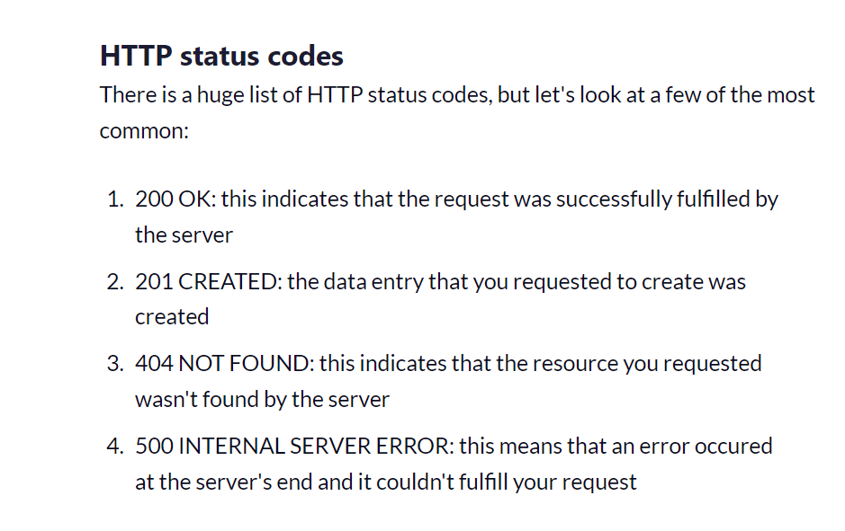
HTTP Status Codes

Slide 8
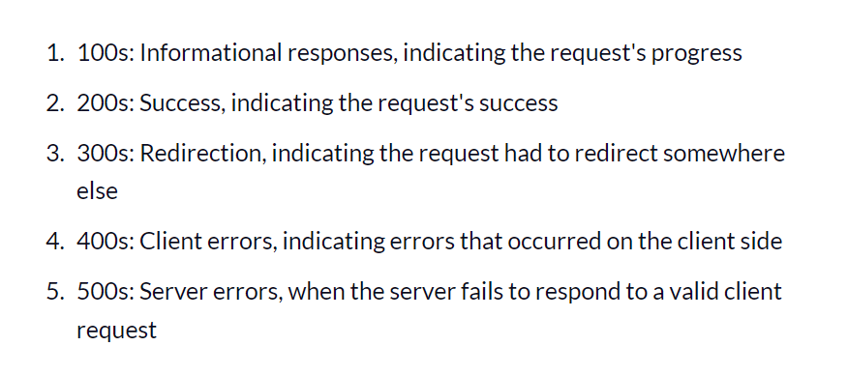
HTTP Status Codes

Slide 9
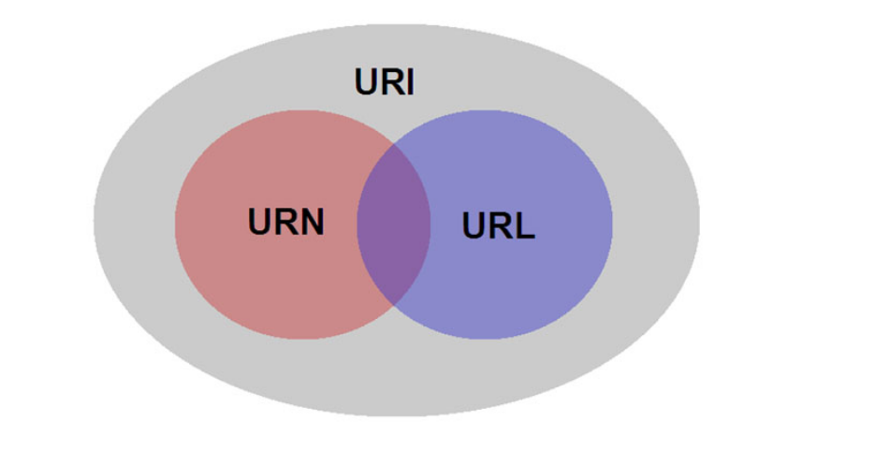
URI ,URL and URN

Slide 10

POSTMAN INSTALLATION AND PROCESS

